Slide 1
Smart Nozzle Design Review
UDRI, February 17th, 2023

Slide 2
Current State of the Project
SolidWorks FEA tutorial - Patrick Hudak
Electro-pneumatic control circuit - Jack Wischmeyer

Slide 3
Current Challenges
Preventing air leaks between the soft robot and the air supply.
Leaks also occur within the soft robot itself that result from tearing of the material
Fine-tune adjusting of the air pressure being supplied to the soft robot. Ideally pressure can be controlled with an Arduino

Slide 4
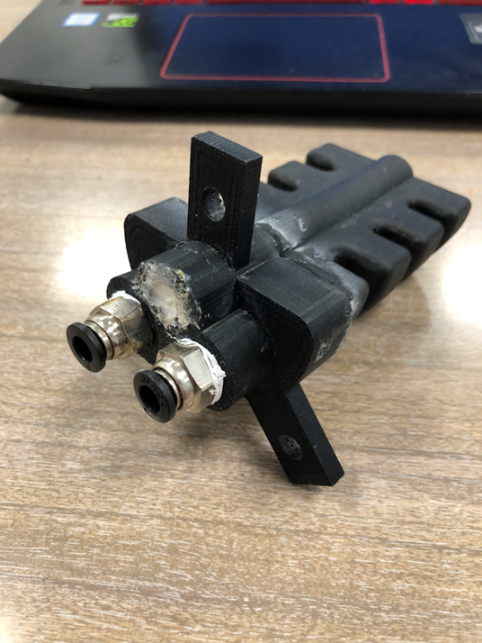
Pressurization Challenges
Creating an airtight seal between the soft robot and any adapter piece is crucial for maintaining pressure
Previous models incorporated an FDM printed adapter between the soft robot and standard quick-disconnects

Slide 5
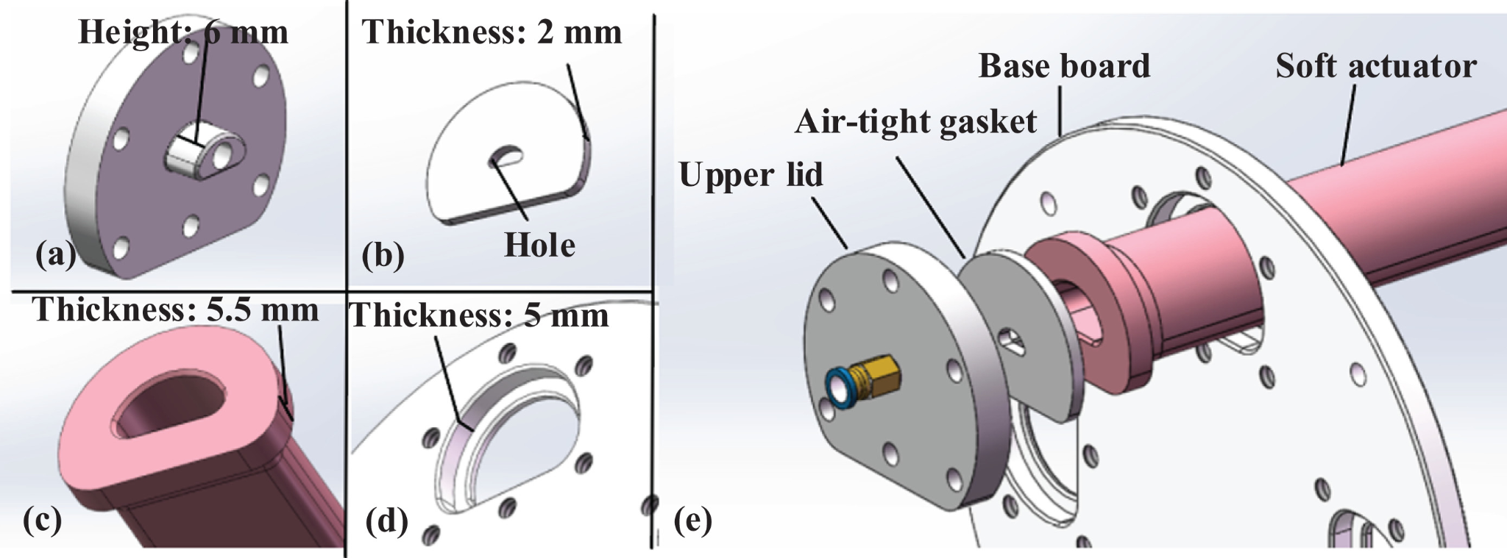
Lid Fixture - Reversed
Designing Against Air Leaks:
PTFE tape is convolved between screw thread of quick plug and internal thread tapped by threading machine (Already doing)
Included air-tight gasket to strengthen air seal: soft, deformable, and smooth
Mold is designed with a thickness of only 2 mm.
When the gasket is clamped, the gasket will develop elastic deformation, spreading over the contract surface and filling in gaps between upper lid and baseboard
Link to Article

Slide 6
Material Quality Concerns
Pressurization of individual chambers:
During testing, smart nozzles could maintain pressure in atmosphere, but would still leak between chambers
All chambers would reach same pressure as a result, essentially a one chamber actuator

Slide 7
Electronics

Slide 10
Material Quality Concerns (cont.)
Four-chamber hose connection failure
Not caused by air pressure, but by tearing of material on worm gear drive clamp

Slide 11
Material Quality Concerns (cont.)
Two chamber model:
Leaking between connector mount and smart nozzle
Adhesive applied to plug leaks, not successful

Slide 12
Two chamber model:
Leaking at top of smart nozzle
Leaking also occurred within the coolant chamber, exposed to atmosphere

Slide 14
SolidWorks FEA
Modeling simulations run without fillets, too difficult for SolidWorks to calculate predicted material response to internal stress

Slide 15
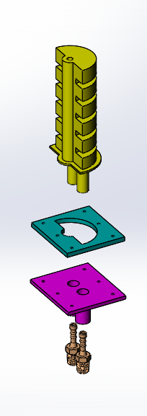
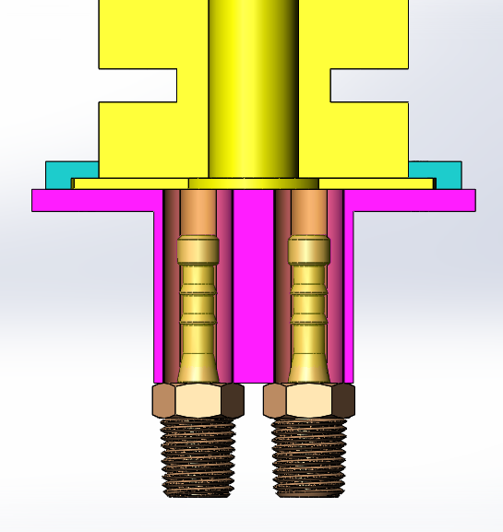
Lid Fixture - Forward
Barbed fittings expand material outwards, Mounting plate provides reaction force inwards,
Air pressure compresses soft robot connection
Fasteners fix top plate (blue) to bottom plate (violet), compresses lip on smart nozzle for support

Slide 16
Conclusion
Primary concerns:
Creating an airtight seal, either with an adhesive or with lip fixture design

